Slide 1
IIOT Lab Project

Slide 2
Team Members:
Vatsal Nanawati - 180929033
Bhaavin Kishore Jogeshwar – 180929048
Akshansh Nath Goswami - 180929064

Slide 3

Brief Introduction
Our IIOT Lab Project is a cough detection system for the Arduino Nano BLE Sense using TinyML and Edge Impulse.

Slide 4
Story
There is a huge need for inexpensive, easily deployable solutions for COVID-19 and other flu related early detection. In this project we show how to use Edge Impulse machine learning on an Arduino Nano BLE Sense to detect the presence of coughing in real-time audio. We built a dataset of coughing and background noise samples, and applied a highly optimized TInyML model, to build a cough detection system that runs in real time in under 20 kB of RAM on the Nano BLE Sense. This same approach applies to many other embedded audio pattern matching applications, for example elderly care, safety and machine monitoring.

Slide 5
Moving too Edge Impulse

Slide 6
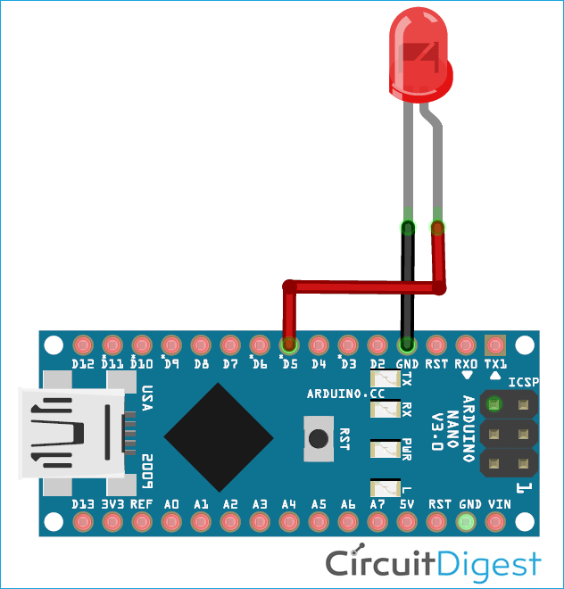
Circuit Diagram if conducted on Arduino BLE Sense:

Slide 7
Individual Contribution
Bhaavin Kishore Jogeshwar - Dealing and Collection of Dataset for the Cough Modelling
Vatsal Nanawati – Algorithm for Neural Network Configuration (2D convolution across the spectrogram )
Akshansh Nath Goswami – Training, Testing and Accuracy of Data collected, followed by Deployment

Slide 8
Resources:
Edge Impulse - https://studio.edgeimpulse.com/studio/31737/deployment
Execution Idea - https://www.sciencedirect.com/science/article/pii/S2352914820300587
Algorithm - Audio Classification Using CNN — An Experiment | by The Experimental Writer | AI Graduate | Medium

Slide 9
Thank you Ma’am

